Slide 1
The ‘Afstammingscentrum’ ISFL Antwerp, July 2023
Notes:
We use the name Afstammingscentrum because it is hard to translate. You could say filiation centre, or support centre for people looking for kinship and family members.

Slide 2
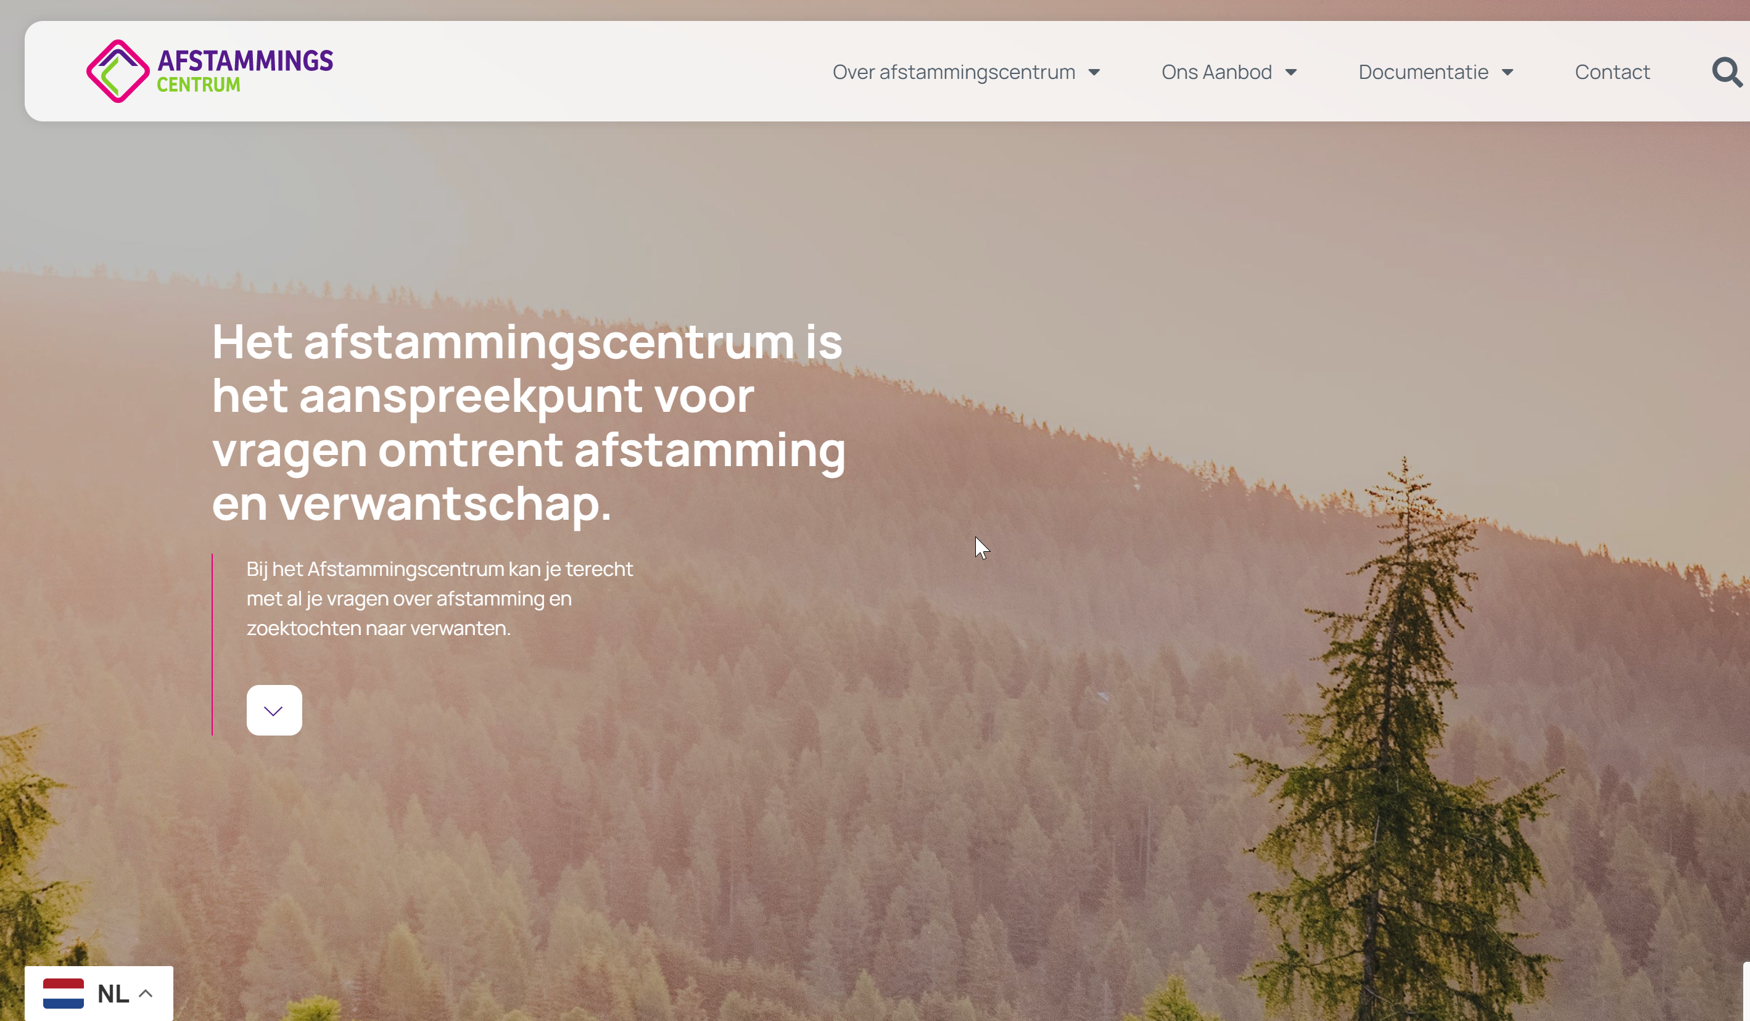
INFORMEREN
Notes:
Homepage: point of reference and contact for all questions on kinship and filiation.
In different languages

Slide 3
LEGAL BASIS - ORIGIN
Flemish law of April 26th 2019
Input of target groups
Open for public on April 1st 2021 (covid time)
Legal mandate: INFORM – SEARCH AND SUPPORT – EXPERTISE
Mission statement: the Afstammingscentrum upholds the fundamental right to know one’s origin and guarantees professional and tailored support to anyone with questions in this matter

Slide 4
TARGET GROUPS
PRIMARY
Adoptees
Donorchildren
Metis colonisation
Family questions and secrets
‘First’/’birth’ parents
SECONDARY
Adoptive parents
Donors
Other relatives
Notes:
Surprised by the questions of a category of ‘others’:
Children born out of wedlock
Unknow (half) siblings
Family secrets….

Slide 5
PEOPLE
Legally embedded in a larger welfare organisation
Staff: coordinator and 4 case workers (3.9 FTE)
Steering group on content: 5 members of the target groups
Board (legal responsibility)
Committed experts (genealogy, family law, genetics, medicine, history, diversity….)
Notes:
Vb Swennen

Slide 6
SEARCH AND SUPPORT
Notes:
Working on search and filiation questions is still the bulk of the every day work. Hardly any budget for the other mandates.
Calls since day 1! More than expected, the center does answer to a real need

Slide 7
Quality handbook
One case worker per case
Psycho social support framework
Step by step
Every question is unique
The client sets the pace
Search info, country sheets, local connections….
Referrals
Waiting list
Result = answer to the said question
Notes:
The given procedure from contact tot follow-up, adapted to every unique question
Contact by the client
Offical application, opening of a file
Intake, formal and explicit agreement on all different steps that can be taken, privacy declaration, explanation on the work
Search actions and support (can take a long time)
Results. What does that mean? A satisfying answer to the actual question (not always real contact in person)
Follow up. We hardly ever really ‘close’ a case. Can also be referral follow up
Cases since april 1st 2021 till beginning july 2023: 670!

Slide 8
SERVICES
Information and tailored advice, with or without actual search
Practical support in searches, interpretation of results…
Psychosocial support (also when there are no results)
DNA-search and database (CME)
Access to (adoption) files and support in this process
Mediation
Add and update search information and -systems, contact persons

Slide 9
Notes:
Since the start april 1st 2021 untill beginning july: 670 cases
- National adoptees include abandoned children and ‘sous-X’
- First parents: 17 national adoptions, 4 transnational (Ethiopia and Guatemala)
- ‘Nothing’ and waiting list (little over 100)

Slide 10
An older man finds his biological father and now they keep in touch.
A girl wants to find her donor. Her lesbian parents asked for a black donor and that was allowed. She is very upset about this.
A man is aware of a hidden family secret that his dad is not his real dad. After his father dies, his mother gives some information and we find a half sibling. We arrange a meeting which is very emotional. They both have mostly positive feelings about this reunion.
In a transnational adoption file there is some confusion with Cyrillic writing but we find a potential first mother. Mediation has been set up.
In cooperation with a local NGO we find a first mother in Guatemala.
An adoptee form South Korea gets our support with an online meeting with her found mother.
A donor child find a potential donor but he refuses mediation. Recently, he has been ordered by the court to give a DNA sample. She is very happy with our support.
Notes:
Result: being able to give what the person asks. This is not always a personal meeting or contact.
The unexpected FAM category is quite important. Sometimes very painful histories. Recently we could bring some peace of mind to a man who was afraid that his sister was actually his mother. We could rule this out after careful DNA and family tree search.

Slide 11
CLIENT EVALUATION
 | 2022 | 2021
Tevredenheid 1e contact | 9,09 | 9,24
Voldoende info over verloop en mogelijk resultaat | 9,23 | 9,24
Info voortgang | 8,22 | 8,72
Beschikbaarheid trajectbegeleider | 8,79 | 9,03
Info website | 8,22 | 7,72
Bereikbaarheid Afstammingscentrum | 8,22 | 7,93
Algemene score | 8,60 | 8,28
Notes:
Better than expected, esp with the waiting list.
Clients do understand the lack of personnel and resources.

Slide 12
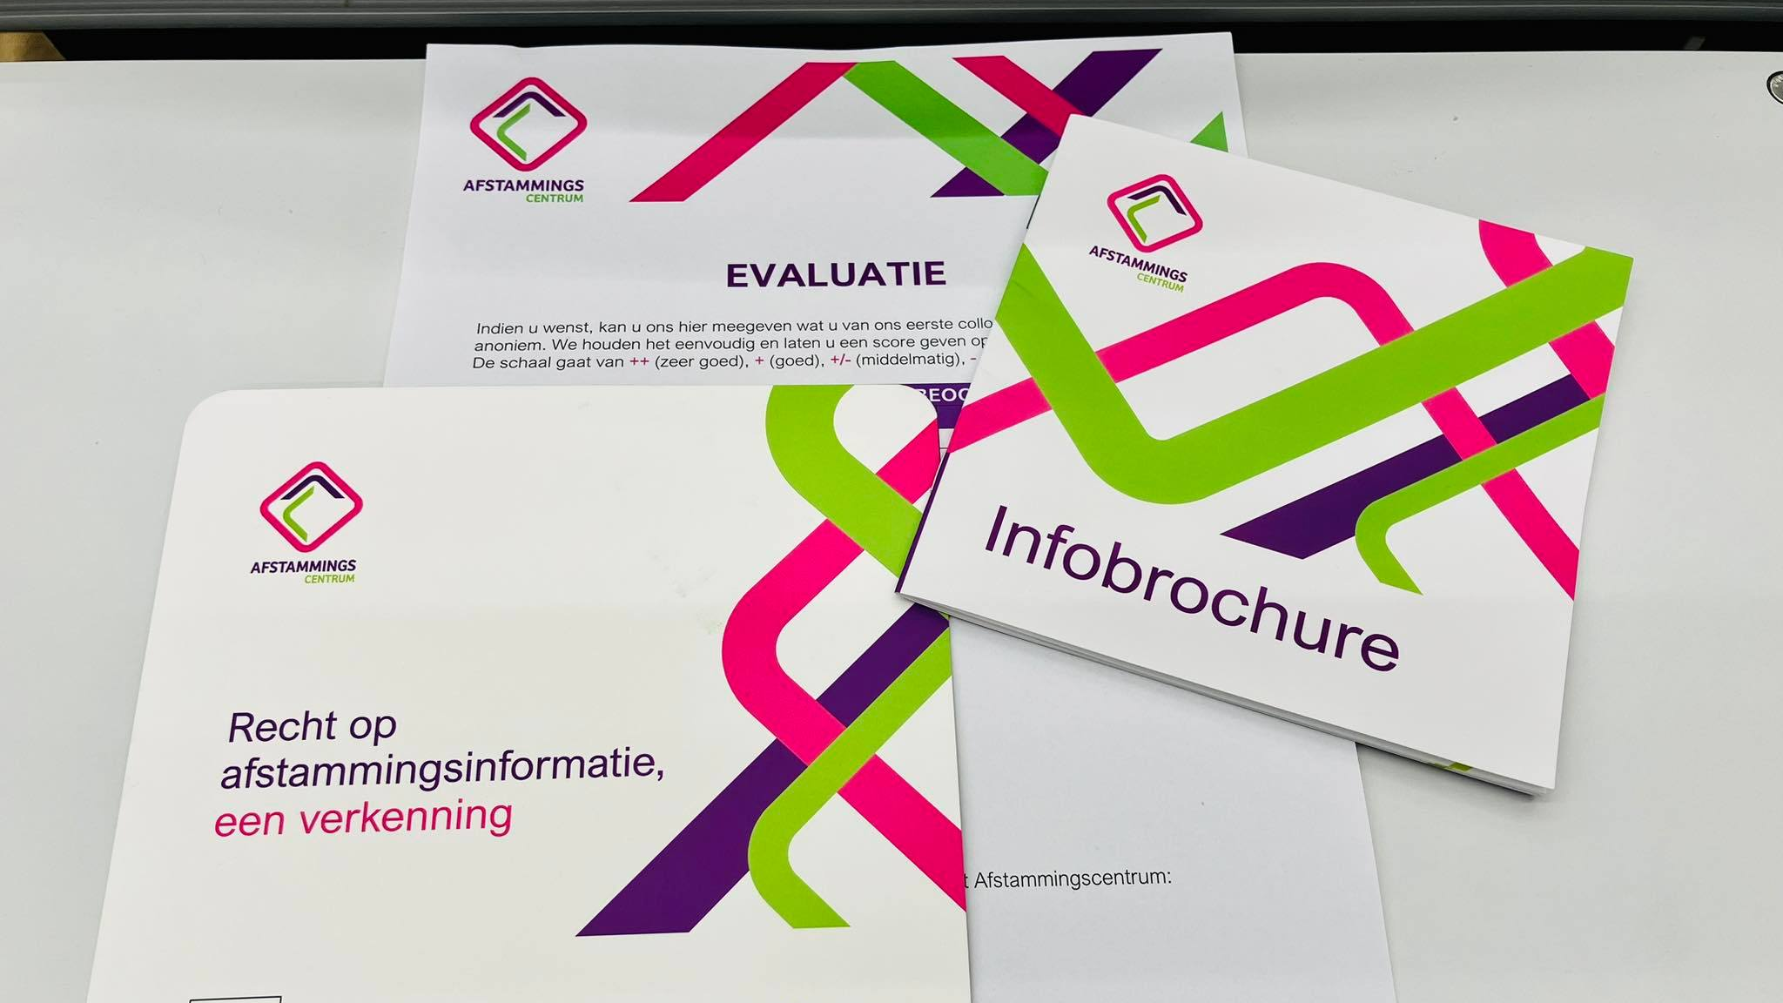
INFORM

Slide 13
INFORM
No campaigns (yet)
Present in traditional media
Active on social media
General and specific brochures, different languages, online and in print (e.g. for donors, for central adoption authorities…)
Presentations, colloquia
Website (multilingual)
Notes:
We don’t have the resources for big campaigns, nor the staff to receive all possible response to that.

Slide 14
Notes:
NEW WEBSITE, multilingual, info on the casework, thematic info, publications, annual reports., documentation….

Slide 15
Notes:
E.g. 2022: 18.647 unique visitors on the website and a total of 39.683 visits. Link between website visits and presence in the general media.
Facebook: around 320 followers, LinkedIn 189 and IG 118

Slide 16
EXPERTISE

Slide 17
EXPERTISE
Continuous update and collection of relevant research, publications, narratives
Sources: our own casework and experience, academic research, narratives and expertise of target groups, court cases (ECtHR…)
Meetings with experts from different disciplines, committed to our work
Trainings, webinars
Developing networks and partnerships
Policy recommendations
Notes:
Lack of time to fully develop this function.
Recommendation on donor anonymity
Meetings with lawyers on testcases

Slide 18
CHALLENGES
Donoranonimity (binding law)
Culture of secrecy (here and in countries of origin)
Ratio staff/cases
Unclear boundaries at times
Shortcomings in our DNA regulation: limited to 1st degree, cost for the client (€85), samples need to be taken by us…
No access to the National register

Slide 19
KEY QUESTIONS
When governments invest millions in the support of family creation (adoption, donor conception, fertility treatment, social freezing…) then why not offer more and better support to the consequences?
Sufficient aftercare, practical and financial (e.g. rootstravels)
Effective legal protection of fundamental rights, review of legislation
Showing respect for existential questions
Is there a right TO a child? Need for broad discussion!

Slide 20
RECENT BREAKTHROUGH
The right to know, to access to information can overrule another’s right to privacy
Deciding on the balance between two fundamental rights: the interest of the plaintiff to know her origins outweighs the minimal violation of the donor’s integrity and his right to privacy (as this last one is not really in increased danger)
Court decision challenging the current law
Curious what will happen next???
Notes:
A grown woman finds out she was donor conceived at the age of 18. This leaves her with immense distress, and she starts searching for her donor. The fact that she had a wonderful childhood, feels good in her family and circle of friends has nothing to do with this psychological pain, identity crisis and feeling of loss. Using commercial DNA databases, she finds 2 potential donors. She relies on the Afstammingscentrum for support and mediation. One possible donor is very cooperative, agrees to check his DNA. Result: NOT her donor.
The other refuses every kind of cooperation. Even though the woman does not want anything more than the reassurance that he is in fact her donor. She’s not after personal contact, alimony or anything else. As he does not agree to any form of even minimal mediation, she finally starts a court case.
Even within the legal context of donor anonymity, the court, in this case, states that her right to know overrules his right to privacy. The court orders the man to give a DNA sample or pay a fine of €1500/day.
The latest news is that he will not appeal this decision….

Slide 21
CONTACT
Rooigemlaan 532 9000 Gent
09/277.04.43
www.afstammingscentrum.be
info@afstammingscentrum.be
Facebook, Instagram, LinkedIn
@afstammingscentrum

