Slide 1
The fundamental right to know The manufactured child Sierre, Nov. 30th 2023

Slide 2
THE “AFSTAMMINGSCENTRUM”
Flemish law of April 26th 2019
Input of target groups since the start, now steering committee
Open for public on April 1st 2021 (covid time)
Legal mandate: INFORM – SEARCH AND SUPPORT – EXPERTISE
Mission statement: the Afstammingscentrum upholds the fundamental right to know one’s origin and guarantees professional and tailored support to anyone with questions in this matter
Notes:
Use Flemish term by lack of good translation
Target groups: adoptees, DC persons, Metis
Established to help people to put their right ‘to know’ into practice and reality.

Slide 3
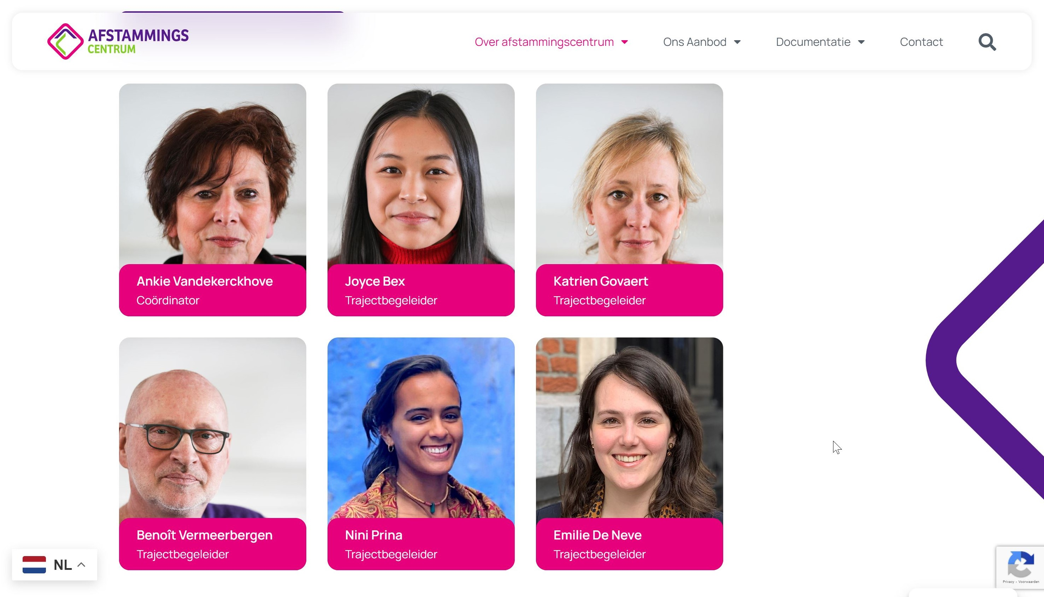
Notes:
Joyce and Benoît are adopted. Nini is 3e generation metis
1 Coordinator 80%
1 case worker at 100%
3 case workers at 80%
1 case worker 50%

Slide 4
TARGET GROUPS
PRIMARY
Adoptees
Donorchildren
Metis colonisation
Family questions and secrets
‘First’/’birth’ parents
SECONDARY
Adoptive parents
Donors
Other relatives
Notes:
Surprised by the questions of a category of ‘others’:
Children born out of wedlock
Unknow (half) siblings
Family secrets….

Slide 5
THE RIGHT(S) APPROACH
CRC (art 3, 7 and 8) and ECHR (art.8)
National legislation e.g. on access to files for adoptees
Case law (national and ECtHR)

Slide 6
SEARCH AND SUPPORT
Notes:
Working on search and filiation questions is still the bulk of the every day work. Hardly any budget for the other mandates.
Calls since day 1! More than expected, the center does answer to a real need

Slide 7
SERVICES
Information and tailored advice, with or without actual search
Practical support in searches, interpretation of results…
Psychosocial support (also when there are no results!)
DNA-search and database (CME)
Access to (adoption) files and support in this process
Mediation, roads to personal contact (?)
Balancing rights
Add and update search information and -systems, contact persons

Slide 8
Quality handbook
One case worker per case
Psycho social support framework
Step by step
Every question is unique
The client sets the pace, detailed agreement
Search info, country sheets, local connections….
Referrals
Waiting list
Result = answer to the question
Notes:
The given procedure from contact tot follow-up, adapted to every unique question
Contact by the client
Offical application, opening of a file
Intake, formal and explicit agreement on all different steps that can be taken, privacy declaration, explanation on the work
Search actions and support (can take a long time)
Results. What does that mean? A satisfying answer to the actual question (not always real contact in person)
Follow up. We hardly ever really ‘close’ a case. Can also be referral follow up
Cases since april 1st 2021 till end nov 2023: over 780!
Waiting list is an issue

Slide 9
EVERY QUESTION IS UNIQUE
Get a clear view of what the real question is, what does the client really want? When? Emotions, memories, narratives…
What does the client bring at the start? Documents, memories, DNA-material, results of previous endeavours…
What can be found, with authorities here and abroad? ​
What contacts do we have in countries of origin? Are they trustworthy?
Not all cases are about actual contacts.
Notes:
Surprisingly: we got questions from the donor side immediately, including from family of deceased donors who volunteered (even though they had to pay a fee).​
Some specifically ask NOT to inform their parents (first parents and adoptive parents) about their search question yet.​
Some do not want any contact for fear of being rejected again
Some started searching earlier and are now resuming this, with renewed courage, guidance and a more structured approach.​
Some ask about identity characteristics of the donor such as character, music preference...​
With Metis it is often about (re)composing the family history, documenting their history and the search for siblings.​

Slide 10
Notes:
Total on Nov 27th: 783
ADOPTED: 182 transnational – 101 domestic adoptions - 20 sous X - 2 foundlings
PARENTS OF ADOPTED OR DC CHILDREN: 19 parents of DC children – 6 parents of transnationally adopted children - 2 parents of domesticly adopted children
FIRST PARENTS/ BIRTH PARENTS: 21 domestic adoptions - 5 transnational adoptions
Varia: 36
‘Niets’: 118 (nog niet benoemd)

Slide 11
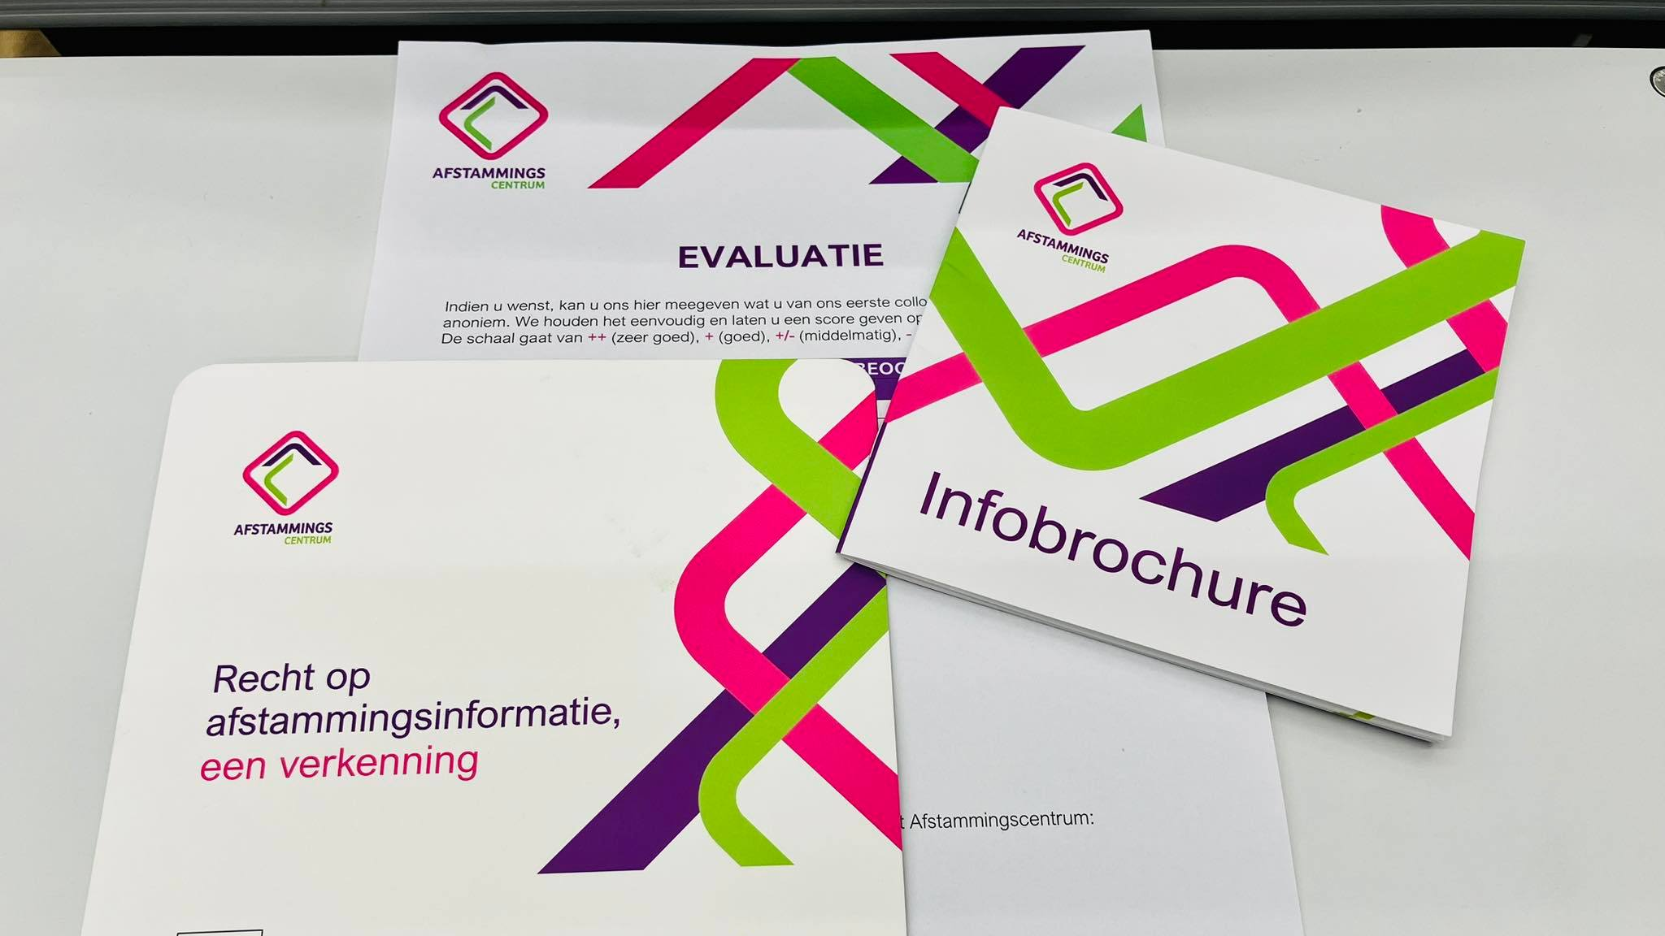
INFORM

Slide 12
INFORM
No campaigns (yet)
Present in traditional media
Active on social media
General and specific brochures, different languages, online and in print (e.g. for donors, for central adoption authorities…)
Presentations, colloquia
Website (multilingual)
Notes:
We don’t have the resources for big campaigns, nor the staff to receive all possible response to that.
Translations on website by Google leave lots te be desired….

Slide 14
EXPERTISE

Slide 15
EXPERTISE
Continuous update and collection of relevant research, publications, narratives
Sources: our own casework and experience, academic research, narratives and expertise of target groups, court cases (ECtHR…)
Meetings with experts from different disciplines, committed to our work
Trainings, webinars
Developing networks and partnerships
Policy recommendations
Notes:
Lack of time to fully develop this function.
Recommendation on donor anonymity
Meetings with lawyers on testcases
Develop more expertise in our case work, intervision, training…

Slide 16
CONTACT
Rooigemlaan 532 9000 Gent
09/277.04.43
www.afstammingscentrum.be
info@afstammingscentrum.be
Facebook, Instagram, LinkedIn
@afstammingscentrum

